Slide 1

JS function & class List
By : Anjali Sharma

Slide 2
Math Functions
Math.random() :
(returns a random number (float value) in range 0 to less than 1 ) (0 <= randomNumber < 1)
Example :- console.log(Math.random());
Math.ceil():
(always rounds a number up to the next largest integer. )
Example :- console.log(Math.ceil(95.90669)); // 96
Random Number in 0-100 : -
Math.ceil(Math.random() * 100);
Random Num in specific range :-
Math.floor(Math.random() * (max - min + 1)) + min

Slide 3
Practice
Create a simple Guess the Number game : Generate a random number between and 100 using JavaScript.
Create a basic UI:
An input field where the user can type their guess (number).
A "Check" button below the input.
A message area to display the result.
When the user clicks the "Check" button:
If the guessed number is lower than the actual number, display: "Too low!"
If the guessed number is higher than the actual number, display:"Too high!"
If the guess is correct, display: "Congratulations! You won the game!"

Slide 4
Function
Arrow Function :
Function Declaration :
function showMessage() {
console.log("Hello");
}
showMessage();
Let showMessage=()=> {
console.log("Hello");
}
showMessage();
Function Expression :
let showMessage = function() {
console.log("Hello");
};
showMessage();

Slide 5
Class List Methods
classList.add() :- for adding a class to an node element
Example- h1Element.classList.add("heading");
classList.remove() :- for removing a class from an node element
Example- h1Element.classList.remove("heading");
Let’s Try : - create a heading and two buttons named “change heading & style” and “remove style” . As clicked on button heading should change accordingly;

Slide 6
Practice
Create a web page where the size of an image can be increased or decreased using buttons, with proper limits and warnings.
Add an <img> element to your HTML and give it an initial width (e.g., 150px).
An "Increase" button (incrementButton) that increases the image width by 5px on each click.
A "Decrease" button (decrementButton) that decreases the image width by 5px on each click.
Add a paragraph or span (warningMessage) to show warning messages when limits are exceeded.
If the user tries to increase it beyond 300px, do not increase it and show a warning message like:- 🔸 "Maximum width is 300px!“
If the user tries to decrease it below 100px, do not decrease it and show a warning like: "Minimum width is 100px!"

Slide 7

Thank You
ALL THE BEST !!!

Slide 8
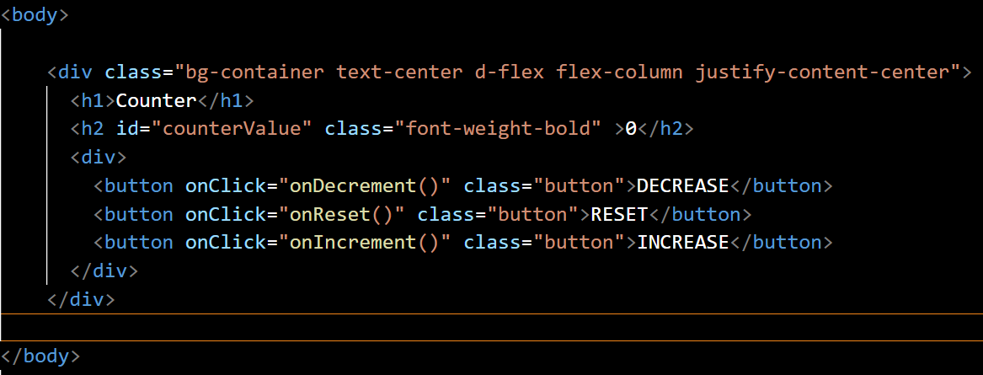
Counter practice code
HTML DOCUMENT

Slide 9
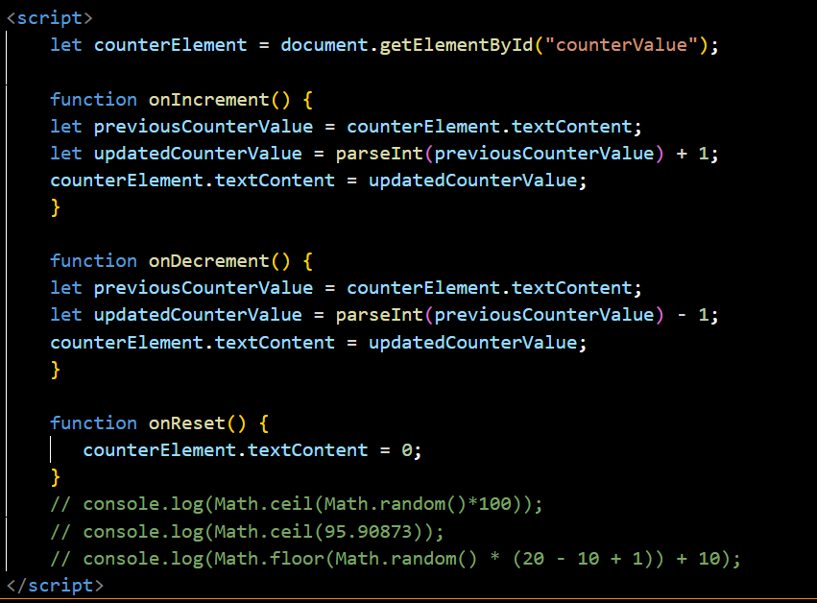
JAVASCRIPT FILE

Slide 10
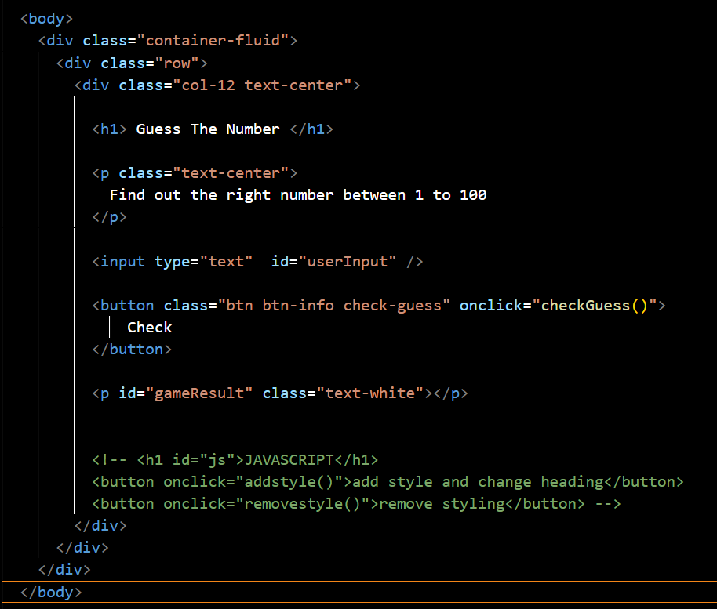
Guessing Game
Html Document

Slide 11
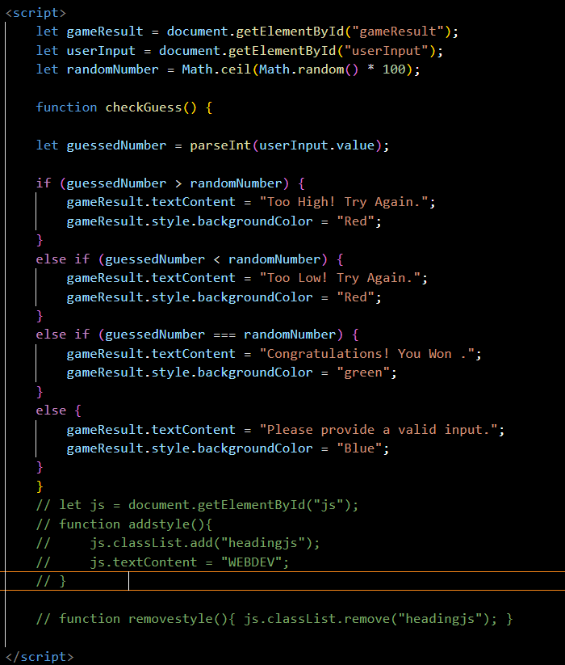
Javascript file

